Slide 1
Organizational
Culture and Strategy

Slide 2
What Is Organizational Culture?
A common perception held by the organization’s members;
A system of shared meaning. It also may be how things are done in the organisation or how members are supposed to behave. These characteristics may be-
Innovation and risk taking, Attention to detail, Outcome orientation, People orientation, Team orientation, Aggressiveness, Stability

Slide 3
What is the function of culture?
Defines the boundary between one organization and others.
Conveys a sense of identity for its members.
  Southwest employees : fun and joking around
Facilitates the generation of commitment to something larger than self-interest.
  Get away from ‘what’s in it for me’ to ‘what can I do to help’?
Enhances the stability of the social system…culture is like a social glue that holds organisations together
It guides and shapes the behaviour and attitude of employees
  For example, when culture is about customer satisfaction – do all you can
As organisations have widened spans of control, flattened structures, introduced teams, reduced formalization, empowered employees…the shared meaning provided by a strong culture points everyone to the same direction

Slide 4
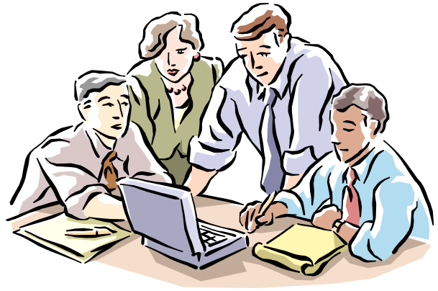
Strong Culture
A culture in which the core values are intensely held and widely shared.
Result of strong culture
Lower employee turnover
Higher agreement among members about what the organisation stands for
Cohesiveness
Loyalty
commitment
Core Values
The primary or dominant values that are accepted throughout the organization.

Slide 5
ELEMENTS USED IN LINKING CULTURE TO STRATEGY
Formal statements of organizational philosophy, charters, creeds, mission and vision statements
Designing physical spaces, facades, and buildings to mimic the company’s beliefs
Deliberate role modeling, teaching, and coaching by leaders.
Explicit reward and status system for employees.
Stories, legends, myths, parables about key people and events.

Slide 6
ELEMENTS USEFUL IN LINKING CULTURE TO STRATEGY
What leaders pay attention to, measure, and control.
Leader reactions to critical incidents and organization crises.
How the organization is designed and structured, i.e. hierarchy.
Organization systems and procedures.
Criteria used for promotion, retirement, and advancement.

Slide 7
Culture can be a Liability:
Barrier to change
An entrenched culture may be inappropriate for a fast changing environment – Mitsubishi, Boeing, Eastman Kodak, Hindustan Motors
cannot be business as usual
Barrier to diversity
Hiring on the basis of age, race, gender, disability, etc., those who are in minority are forced to conform by strong cultures…instead of bringing the differences into the organisation
Barrier to acquisitions and mergers
Other than financial advantage or synergy, a good cultural compatibility is important for the new entity to survive…AOL – Time Warner ($183 b merger 2001)‏

Slide 8
Creating & sustaining cultures ::: How Culture Begins
The ultimate source of an organisation’s culture = its founders
Founders hire and keep only employees who think and feel the same way they do.
Founders indoctrinate and socialize these employees to their way of thinking and feeling.
The founders’ own behavior acts as a role model that encourages employees to identify with them and thereby internalize their beliefs, values, and assumptions.

Slide 9
Sustaining cultures
Selection
  Concern with how well the candidates will fit into the organization.
  Provides information to candidates about the organization.
Top Management
  Senior executives help establish behavioral norms that are adopted by the organization.
  Through what they say and how they behave, senior executives establish norms that filter down
Socialization
  The process that helps new employees adapt to the organization’s culture.

Slide 10
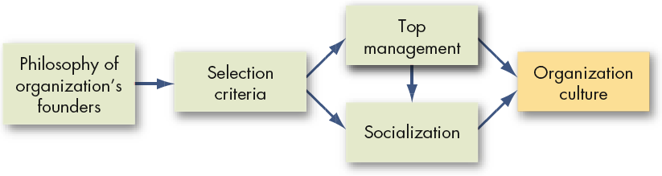
How Organization Cultures Form

Slide 11
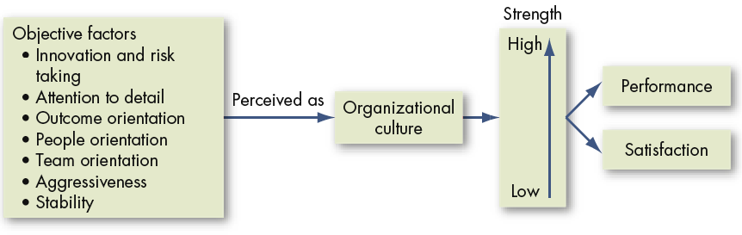
Nutshell : How Organizational Cultures Have an Impact on Performance and Satisfaction

Slide 12
How Employees Learn Culture
Stories
    Nike’s Bill Bowerman – spirit of innovation [Steve Prefontaine’s battle to make running a professional sport – Nike’s commitment to help athletes]
    Stories anchor the present in the past and legitimises the current practices
  Slogans
    Catchy phrases that companies use to capture customers’ attention to their products. [It’s not TV. Its HBO. Its not oil. Its liquid engineering]
Rituals
  Repetitive sequences of activities that expresses and reinforce key values of the organisation – e.g. Company chant – IBM, Novell
Material Symbols
  Office layout can be informal = openness, equality, flexibility, creativity
  The size of the office, furnishings, attire, perks, etc.
Language
  Jargon of the organisation related to its products, customers, suppliers, key people
  This terminology acts as a common denominator that unites members to the culture.

